Slide 1
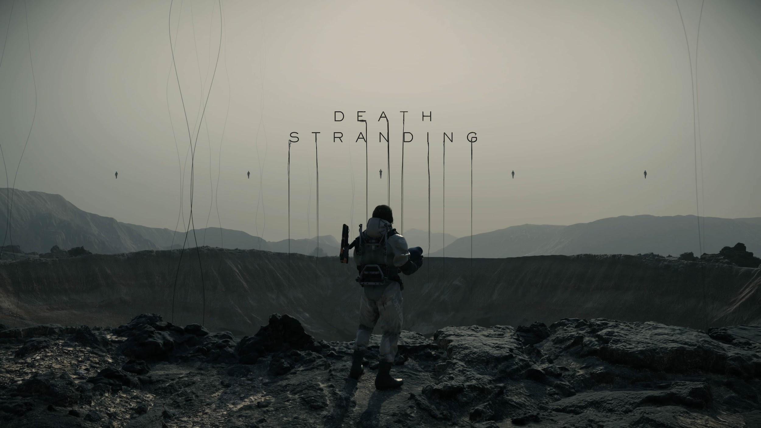
Sentiment Analysis - A Machine Learning Approach into Hideo Kojima's Divisive Platformer
By Omar M. Hussein, Julian A. Ruggiero, & Randy Leon

Slide 2


Hideo Kojima is the director, designer, and creative auteur behind his first solo project, Death Stranding. As former VP of Japan’s Konami Digital Entertainment, he ventured off to create his own game studio.
Death Stranding is Kojima’s first independent video game title. It was a highly anticipated release.
“90% of what is considered "impossible" is, in fact, possible. The other 10% will become possible with the passage of time & technology.” - Hideo Kojima

Slide 3
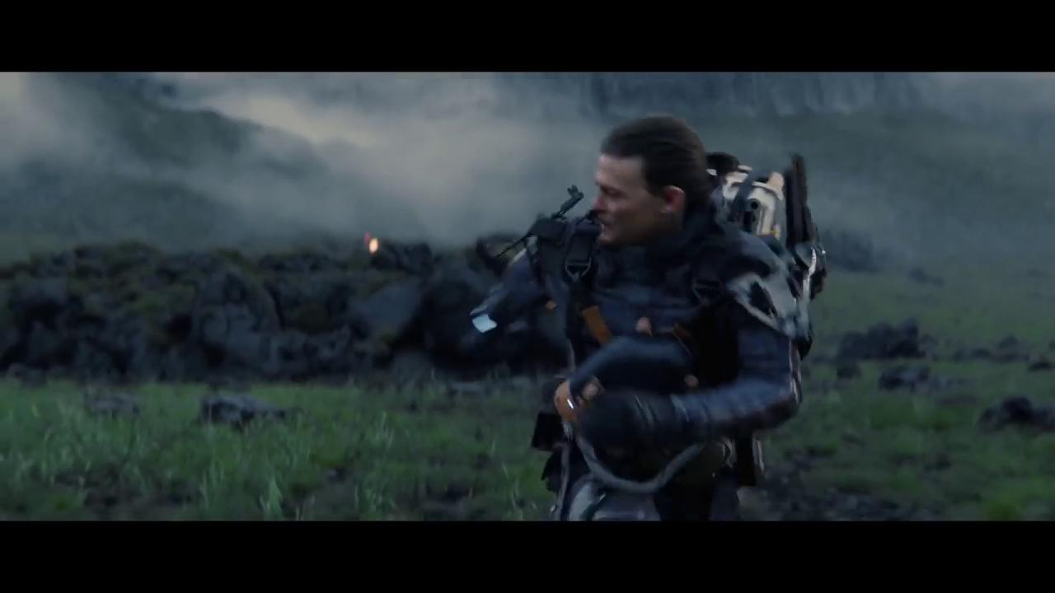

Slide 4
Agenda:
Data sourcing.
Preprocessing.
Feature engineering - Bag of Words.
ML algorithm development.
Death Stranding data collection and storage.
Twitter data geo-location + EDA.
Death Stranding Tweets classification.
Visualizations and conclusion. (i, ii, iii)
References.

Slide 5


Data sourcing.
Our data sources:
Stanford University’s “Sentiment140 dataset with 1.6 million tweets”. Found on Kaggle.com
Approx. 30,000 real tweets we gathered using Python Tweepy Library.

Slide 6
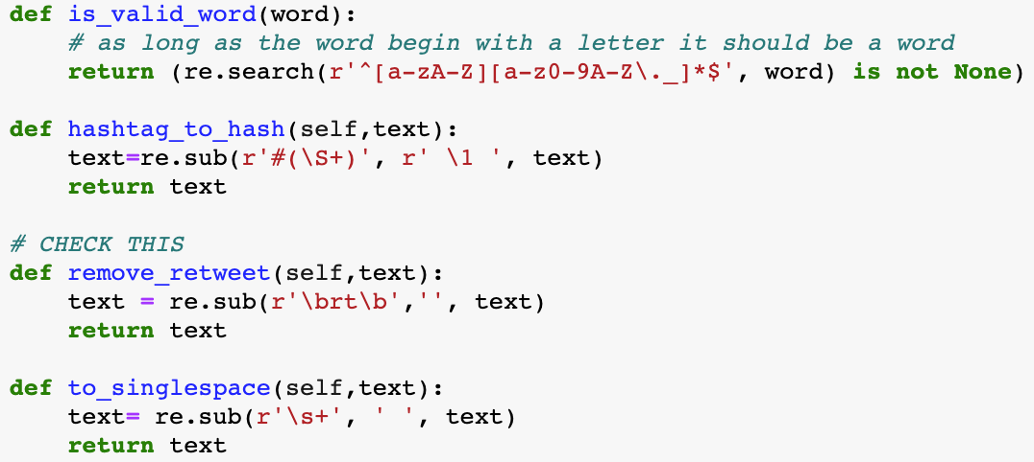
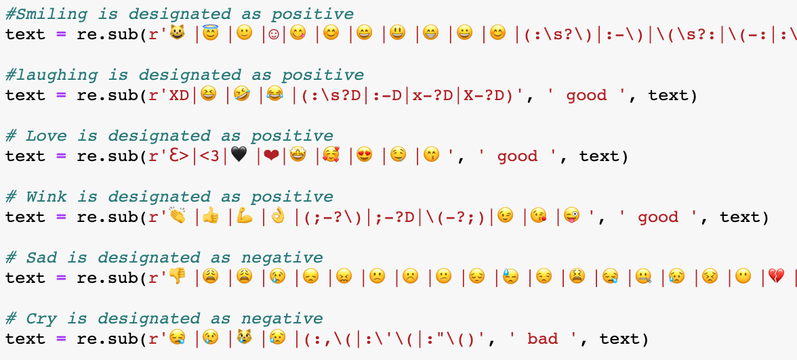
Preprocessing.
Cleaning data using regular expressions.
Ridding tweets of stopwords, special characters, emojis, etc.
Ensuring tweets are also rid of usernames, URLS, and that they contain actual words.
Notes:
Preprocessing still buggy

Slide 7
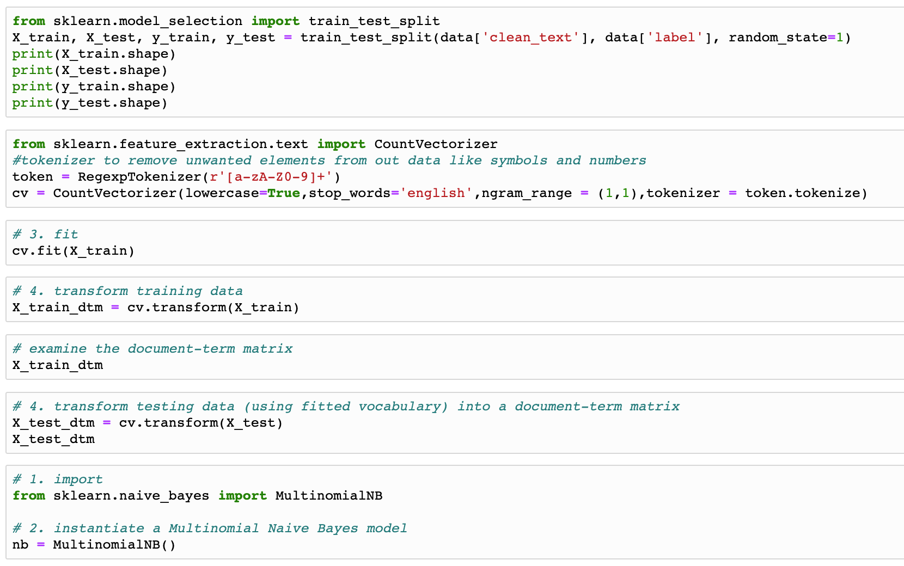

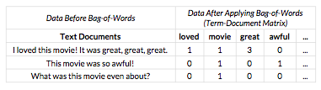
Feature engineering - Bag of Words.
Our text sets needed to be transformed into vectors to work with our ML model.
Utilized concepts of tokenization and a document-term matrix using scikit-learn’s CountVectorizer.
Further preprocessing was done to ensure usability of dataset.

Slide 8
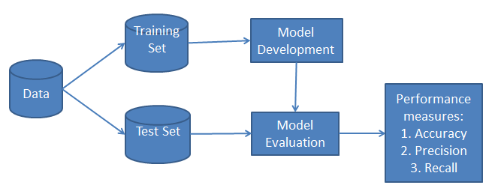
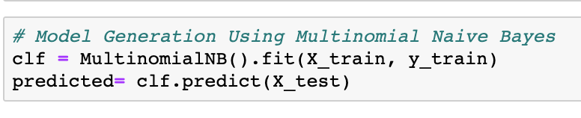
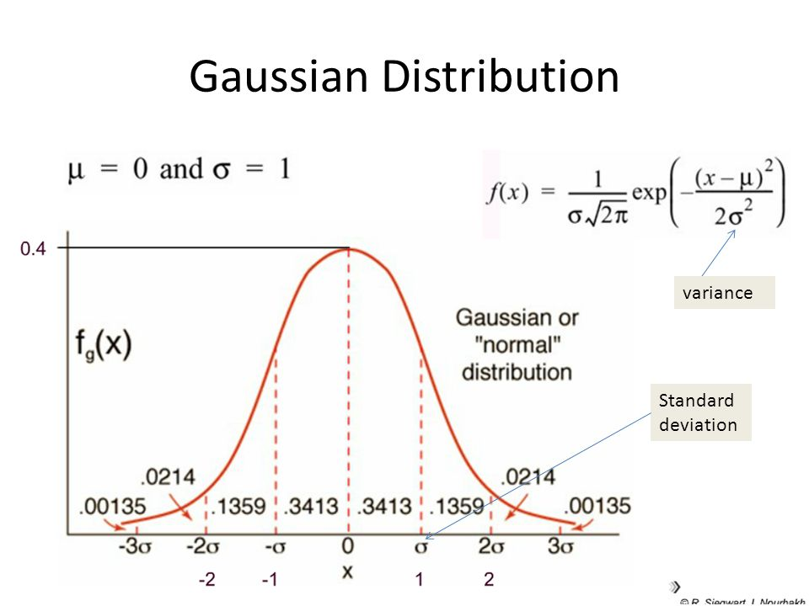
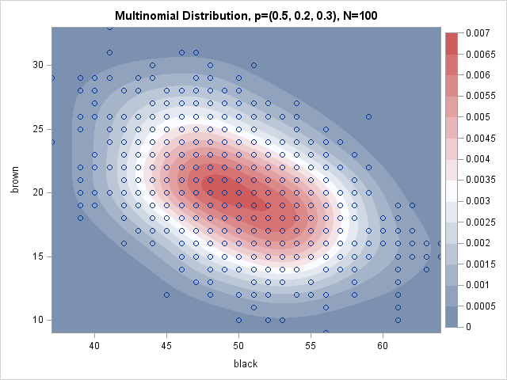
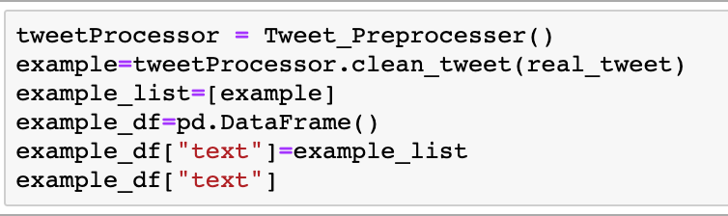
ML algorithm development.
First, we split our dataset into a training set and a test set.
Next, a classifier was built using multinomial Naive Bayes.
We tested its accuracy and ability.

Slide 9
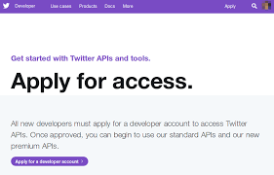

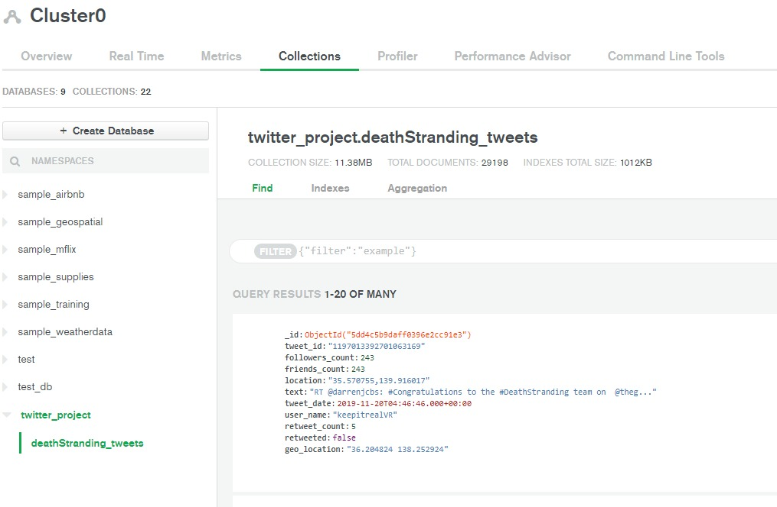

Death Stranding data collection and storage.
A Twitter Dev account was needed to source the tweets.
Python’s Tweepy library was needed to communicate with Twitter’s API.
MongoDB was used to store our collected tweets in the cloud.

Slide 10
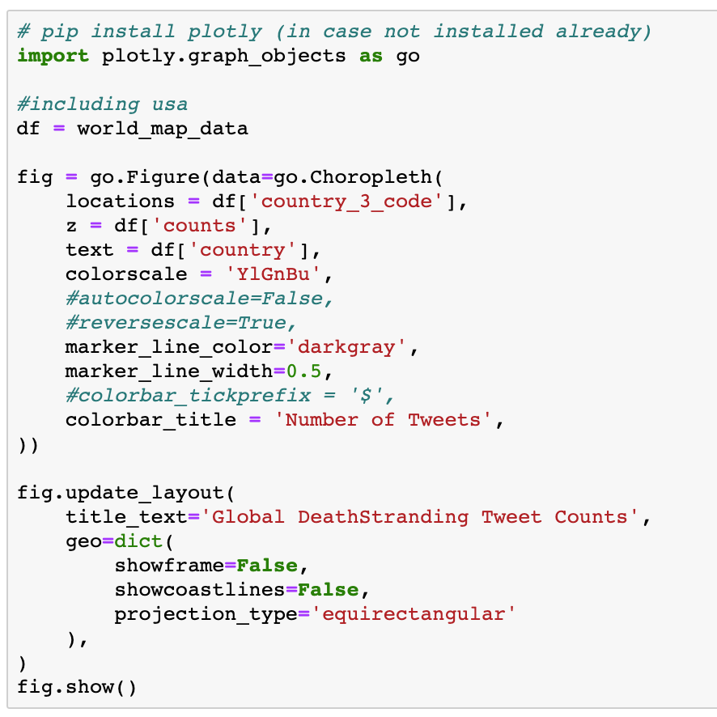

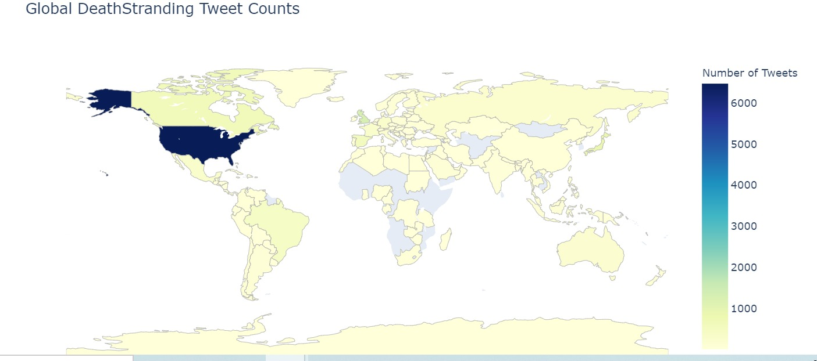
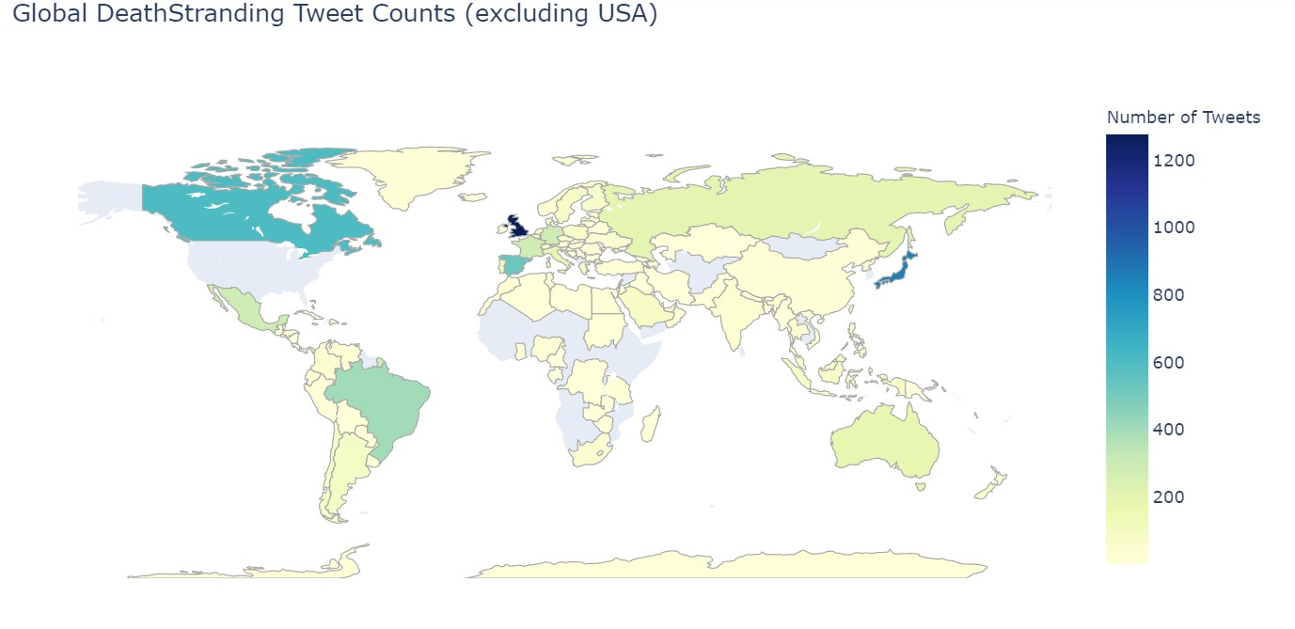
Twitter geo-location data + EDA.
Purpose of project was to obtain demographics of Twitter data.
Google’s GeoCoding API converts addresses to geographic coordinates.
Dataframe from gathered coordinates was used to create choropleth map using Plotly to visualize where all of our tweets originated from.

Slide 11

Death Stranding Tweets classification.
We took the Multinomial Naive Bayes classifier and applied it to our 30k tweets about Death Stranding to get sentiments. (positive or negative)
With our results, we visualized the frequency distributions of both the positive and negative Tweets.

Slide 12
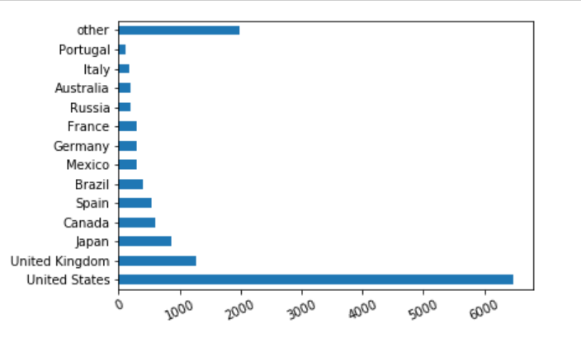
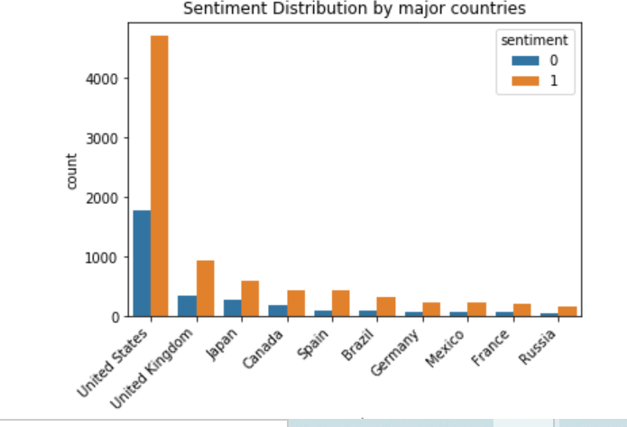
Visualizations and conclusions.
- The US had more tweets by far on Death Stranding than any other country in our dataset by roughly five thousand Tweets.
- Here, we can see the breakdown of the previous graph with respect to positive (orange) and negative (blue) sentiments.

Slide 13
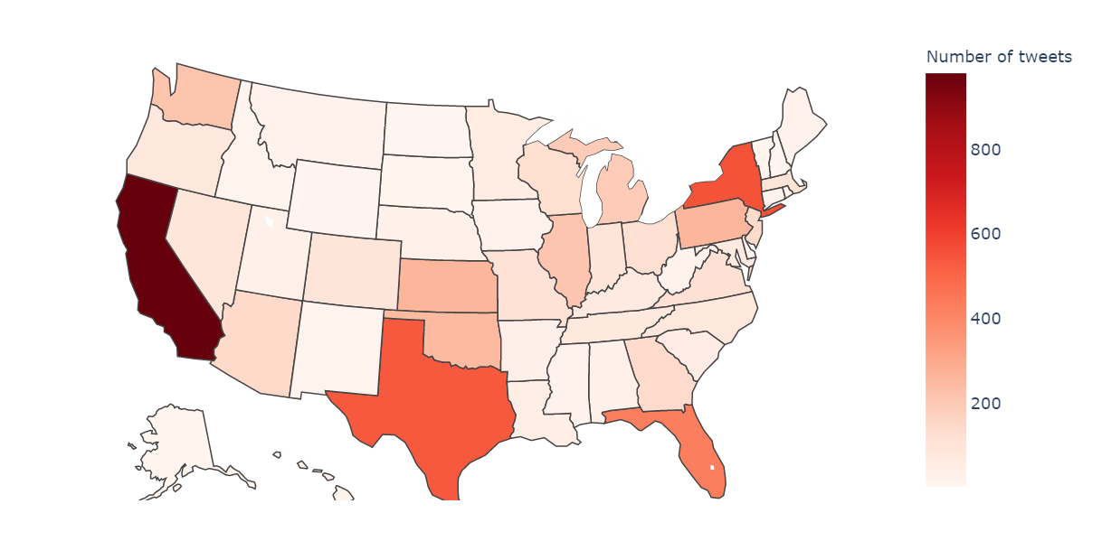
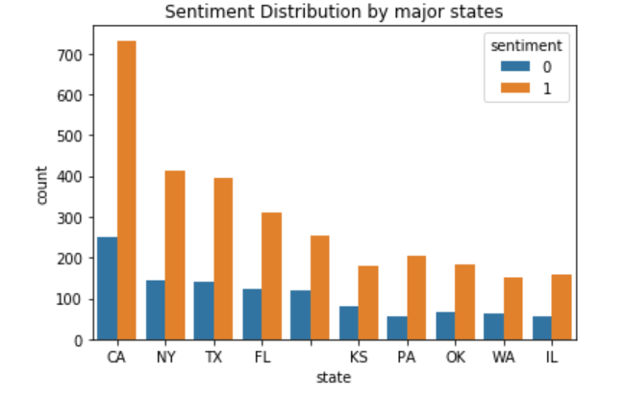
Visualizations and conclusions ii.
- States that are home to the US’s most populous metropolitan areas showed the most Twitter activity.
- California has more Tweets about Death Stranding than any other state, but the ratios of positive to negative Tweets seem about even across the top ten.

Slide 14
Visualizations and conclusions iii.
We have found that the overwhelming majority of those who Tweeted about this game had good things to say about it.
This game had the most buzz in the USA, UK, and Japan, with mostly positive responses from each country as well.
U.S. States that had dense metropolitan areas (NYC, LA, HOU, MIA) had the most to say on Twitter about Death Stranding.
Despite what critics may say, and the mixed reviews found on various video game publications, Twitter gave this game more praise than criticisms both on a global and domestic scale.

Slide 15
References
IGN’s YouTube Post showing Death Stranding’s Official Cinematic Trailer: https://www.youtube.com/watch?v=Mpn-MC2B6Zc&ab_channel=IGN&t=55s
Go, A., Bhayani, R. and Huang, L., 2009. Twitter sentiment classification using distant supervision. CS224N Project Report, Stanford, 1(2009), (Stanford University’s paper for their dataset): https://cs.stanford.edu/people/alecmgo/papers/TwitterDistantSupervision09.pdf
Twitter logo PNG: https://www.pngfans.com/middle-674511fecc62ffca-twitter-logo.html
Stanford logo PNG: https://identity.stanford.edu/name-emblems.html
MongoDB - The database for modern applications: https://www.mongodb.com/
Hideo Kojima’s Biography found on IGN: https://web.archive.org/web/20071116080116/http://stars.ign.com/objects/963/963391_biography.html
Hideo Kojima’s quote on the impossible: https://www.gamasutra.com/view/news/113883/GDC_How_Kojima_Defied_The_Impossible_Throughout_Metal_Gears_History.php
Hideo Kojima’s headshot in blackspace: https://www.wired.com/2016/06/hideo-kojima-death-stranding-interview/
Naive Bayes image: https://www.datacamp.com/community/tutorials/naive-bayes-scikit-learn
“Bag of words” image: https://www.datasciencecentral.com/profiles/blogs/an-intro-to-natural-language-processing-in-python-framing-text
Twitter Developer Account Screenshot: https://wptweetboost.com/example-of-the-twitter-developer-account-application-process/
Sentiment Analysis image: https://hackernoon.com/5-best-sentiment-analysis-companies-and-tools-for-machine-learning-7v1ru321n
Google Geo API logo: https://console.cloud.google.com/marketplace/details/google/geocoding-backend.googleapis.com?pli=1
Sci-kit Learn image: https://github.com/scikit-learn/scikit-learn/blob/master/doc/logos/scikit-learn-logo.svg

Slide 16


